Slide 1
Data Management 101(102)
Keith White and Andrew Levin

Slide 2
Session Agenda
(Overview) Data Workflow & Management Topics
Poll the group to identify which topics to focus on today.
Discuss Selected High Priority Topics
Work through relevant data tutorials in a Jupyter Notebook

Slide 3
Topics – General Tools
Bash: Basic linux commands for any computer task, focus on data workflows and management
Git and GitHub: Version control your code and easily store/share it via a cloud-based platform
Tar: Default command-line tool to create and extract archive files (.tar.gz or .tz most often)
Rclone: Command-line tool to transfer files between local and remote locations (like OneDrive…)
VS Code: A popular, powerful, lightweight programming workspace (an IDE) compatible with python scripts and Jupyter notebooks
Jupyter: A popular open-source project for interactive computing, JupyterLab is the latest web-based interactive development environment for notebooks, code, and data

Slide 4
Topics – Python-Related Tools
Amount of prerequisite knowledge
Conda: (Miniconda/Anaconda) Install and manage programming environments and packages
NumPy: “The fundamental package for scientific computing with Python”, efficiently manage data
Matplotlib: “Matplotlib is a comprehensive library for creating static, animated, and interactive visualizations in Python”
Object-oriented programming: Intro to using classes in Python
Xarray: Package that builds on numpy and pandas to enable labled multidimensional arrays
Dask: Library for parallel and distributed computing, enables big data work in Python
Zarr: File storage format for distributed n-dim arrays, works natively with Xarray and Dask

Slide 5
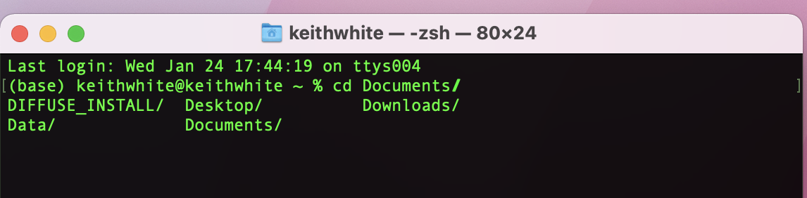
Bash
What is Bash?: You’ve probably used this with or without knowing at the beamline, or wished you knew it. Bash, or the Bourne Again SHell, is a command-line interpreter widely used in Unix-based operating systems. It allows users to type text commands to perform operations like file manipulation, program execution, and other system tasks.
Essential Bash Commands
cd (Change Directory)
cd [directory]: Changes the current directory.
Example: cd /Documents/
cd .. (Parent Directory)
cd .. (cd space dot dot): Moves up one directory level.
ls (List)
ls [options] [directory]: Lists files and directories.
Options: -l (detailed list), -a (all files).
pwd (Print Working Directory)
pwd: Displays the current directory path.
Bash Scripting Basics
Bash Scripts (.sh)
A file with .sh extension containing a series of commands in bash.
Begins with #!/bin/bash (shebang) to specify the interpreter.
Uses
Automate tasks, combine commands, schedule operations, etc.
Very very useful for bulk data transfer from the beamline server to your machine (if you know how to use it.)
Notes:
Why do I care?: Bash is widely used at beamlines, and is useful on your own personal machine for help with coding tasks.

Slide 6

Git and GitHub
What is Git?: Git is a distributed version control system designed to handle everything from small to very large projects with speed and efficiency. It allows multiple developers to work on a shared codebase, managing changes and ensuring code integrity.
What is GitHub?: GitHub is a web-based platform built around Git. It provides a graphical interface for managing repositories and includes features like issue tracking and collaborative tools.
Essential Git Commands
git init
Initializes a new Git repository.
Usage: git init
git clone
Creates a copy of an existing repository.
Usage: git clone [URL]
git add
Adds files to the staging area before committing.
Usage: git add [file] or git add . (for all changes)
4. git commit
Saves changes to the local repository.
Usage: git commit -m "[commit message]"
5. git push
Uploads local repository content to a remote repository.
Usage: git push [remote] [branch]
6. git pull
Fetches and merges changes from a remote repository to the local repository.
Usage: git pull [remote]

Slide 7

Tar Files (.tgz)
What is a Tar File (.tgz)?: Tar (Tape Archive) is a file format and a command line utility for collecting many files into one archive file. Often used for distribution or backup purposes.
`.tar.gz` is also a Tar file but compressed with GNU Zip (gzip).
Tar (.tgz) Creation from Folder
Open Terminal
Access the command line interface.
Navigate to the Parent Directory of project_data
Command: cd /home/user/
Create a .tgz File
Command: tar -czvf project_data.tgz project_data
Breakdown:
tar: Invoke the tar utility.
-c: Create a new archive.
-z: Compress the archive using gzip.
-v: Verbose; show the process.
-f: Specify the filename of the archive.
project_data.tgz: Name of the resulting archive.
project_data: Directory to be archived and compressed.
Tar (.tgz) Extraction Process
Open Terminal
Access the command line interface.
Navigate to the Directory Containing archive.tgz
Command: cd /path/to/directory
Replace /path/to/directory with the actual path.
Extract the .tgz File
Command: tar -xzvf ar chive.tgz
Breakdown:
tar: Invoke the tar utility.
-x: Extract files from the archive.
-z: Uncompress the gzip archive.
-v: Verbose; show the process.
-f: Specify the filename of the archive.
archive.tgz: The archive file to be extracted.

Slide 8


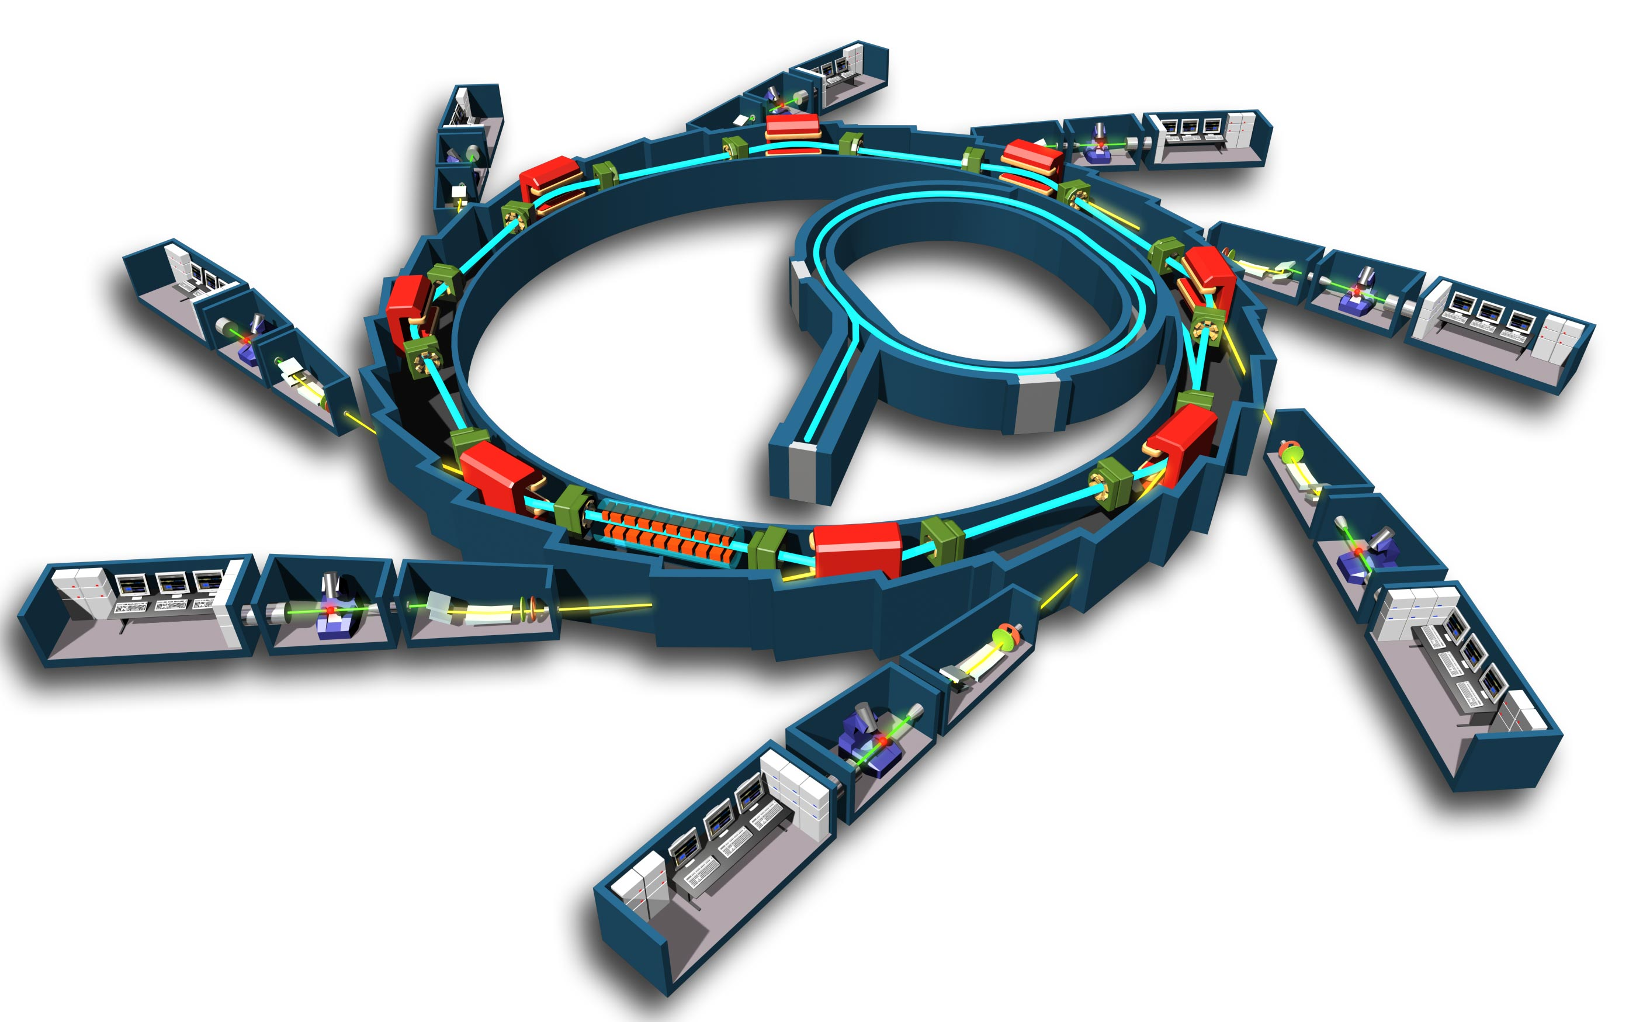


Rclone
What is Rclone?: Rclone is a command-line program to manage files on cloud storage. It supports various cloud storage providers, including OneDrive. Rclone enables syncing, copying, and transferring files between local and remote locations.
some beamline
you
Transferring Files Between Local Machine and OneDrive
Upload to OneDrive: rclone copy /local/directory onedrive_remote:/remote/directory
Download from OneDrive: rclone copy onedrive_remote:/remote/directory /local/directory
Install Rclone in a Conda Environment: (Optional) Create a new Conda environment: conda create --name rclone_env
Activate the Environment: conda activate rclone_env
Install Rclone: conda install -c conda-forge rclone

Slide 9


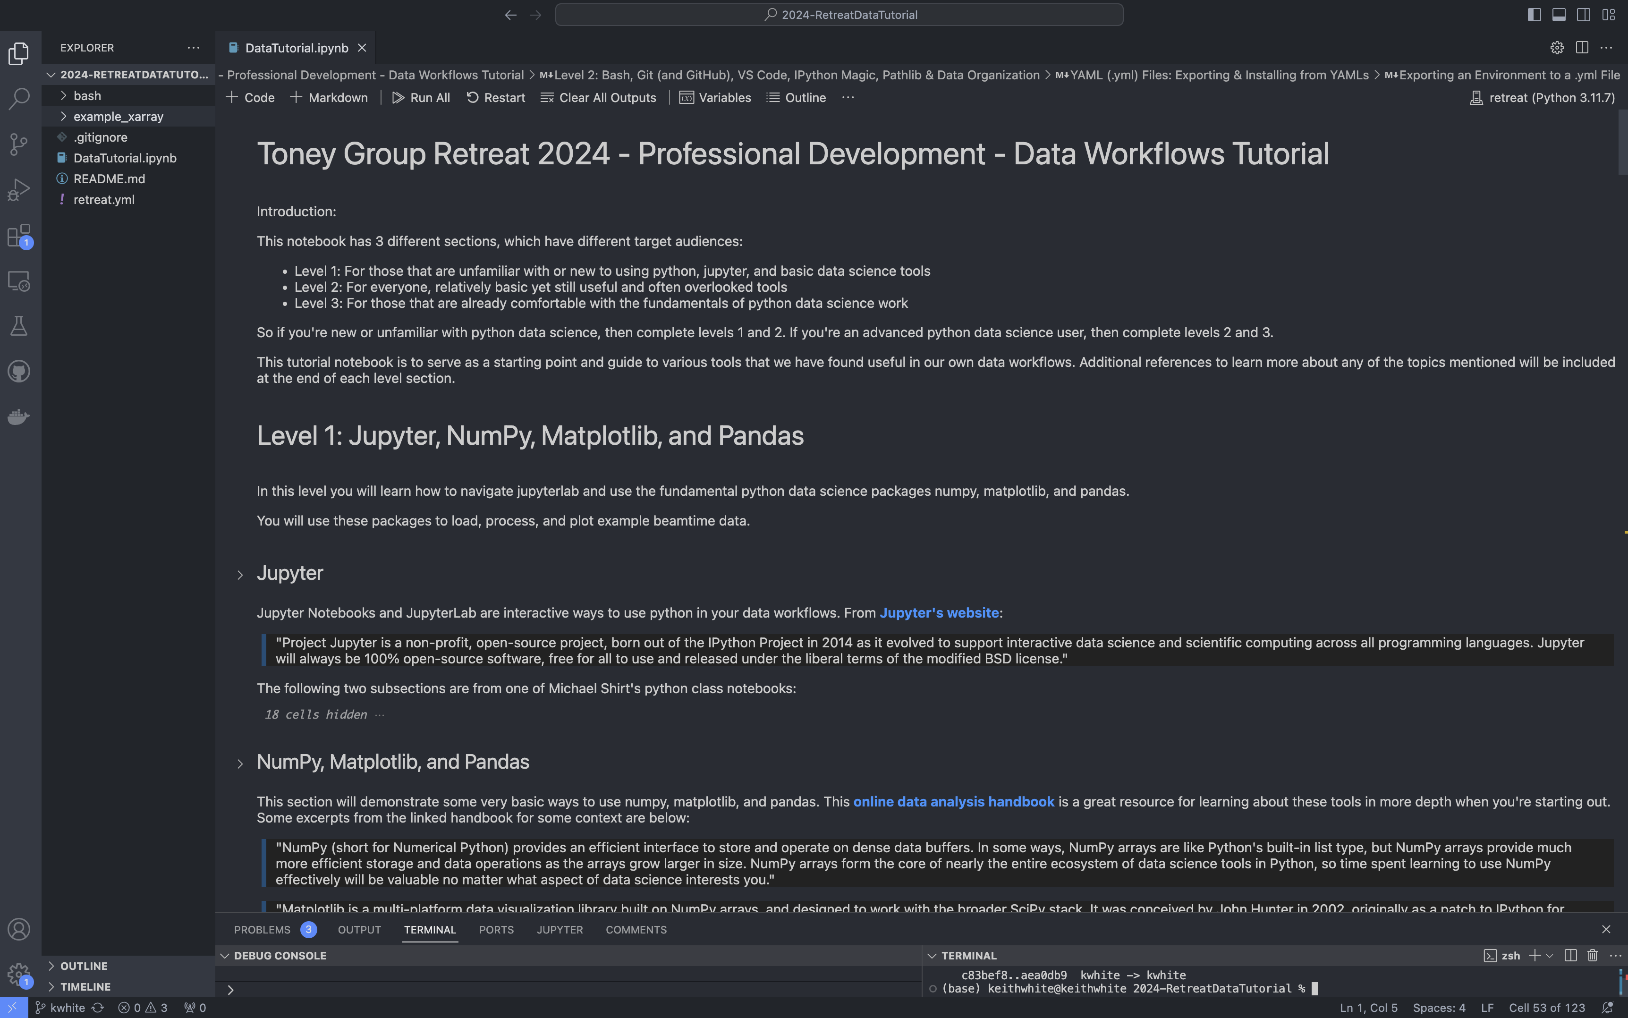
Visual Studio (VS) Code
What is Visual Studio Code (VS Code)?: VS Code is a powerful, open-source code editor developed by Microsoft. It offers an array of features that enhance productivity and ease the development process for a variety of programming languages.
Key Features of VS Code
Jupyter Integration: Allows running and interacting with Jupyter notebooks, supporting languages like Python, Julia, and R.
GitHub Integration: Direct integration with GitHub for repository cloning, committing changes, and managing pull requests and issues.
Support for Multiple Programming Languages: Offers extensive language support with IntelliSense for coding assistance and debugging.
Integrated Terminal Access: Built-in terminal for Bash, PowerShell, and other command lines, enabling shell commands and script execution.
Conda Environment Management: Facilitates the creation and management of Conda environments, allowing easy switching between them.
Extensions and Customization: Access to a vast marketplace of extensions and options to customize themes, shortcuts, and editor settings.

Slide 10

JupyterLab and JupyterHub
What is Jupyter?: A non-profit, open-source project designed for interactive data science and scientific computing across all programming languages (we use Python):
IPython: A powerful interactive shell with many additional tools for data science
Jupyter Notebook: The most common filetype to work with in Jupyter, interactively run code and save both the input and output. Create and use notebooks for workflows, education, etc.
JupyterLab: A newer web-based development environment that lets you work with notebooks, manage files, use bash, and more. A more flexible and useful way to use Jupyter.
JupyterHub*: JupyterLab, but hosted remotely. BNL NSLSII JupyterHub is available to all users for powerful remote computing. Knowing how to use tar, rclone, and conda is helpful.

Slide 11

Conda
What is Conda?:
Open-source package management and environment management system
Simplifies installation and management of software dependencies and environments
Ideal for complex data science projects with specific version requirements
Installation:
Install with: miniconda installer (recommended), anaconda installer (pre-installs many GB of packages, but you get a GUI), or homebrew
After installing, run “conda init [shell]” to add conda to your local shell of choice (bash, zshell, powershell, etc)
Common commands:
conda activate [environment name]
conda env list
conda list
conda create –n [name] python numpy (etc)
Refer to conda’s cheat sheet and rich documentation for more!

Slide 12
NumPy
What is NumPy:
Fundamental package for scientific computing in Python
Provides support for large, multi-dimensional arrays and matrices
Offers a wide range of mathematical funcions to operate on these arrays.
Why you need to know NumPy:
Extremely widely used
Make your code orders of magnitude more efficient

Slide 13
Matplotlib
What is Matplotlib:
Comprehensive library for creating static, animated, and interactive visualizations in Python.
Offers extensive plotting functions for graphs, charts, and other visual representations of data.
Widely used for data visualization in both simple and complex use cases.
Why you need to know Matplotlib:
Extremely widely used
Make plots of your code, from quick viewing to publication-level figures

Slide 14
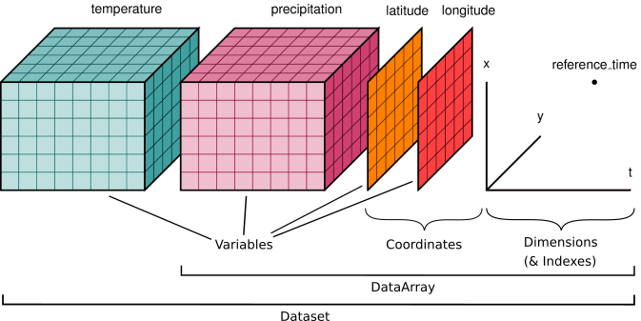
Xarray
What is xarray?: Xarray is a python package that provides a toolkit and data structures for N-dimensional labeled arrays. The package includes features such as:
Label-based indexing for data dimensions.
Inter-operability with numpy, matplotlib, dask, etc.
Various input/output options to slicing and displaying data.
Advanced data manipulation and reduction tools.
S. Hoyer and J. Hamman, 5, 10 (2017).

Slide 15
Data workflow tools:
Rclone: command-line program to manage cloud storage files
Works on most OS, flexible installation methods (executables, homebrew, conda, etc.)
Xarray: python package that builds on numpy & pandas
Enables assigning dimensions, coordinates, and attributes to n-dim arrays
Dask: python library for parallel computing
Dask arrays reduce memory usage & time for slicing large arrays, supported by Xarray
Zarr: file storage format chunked / compressed / n-dim arrays
Readily works with Xarray + Dask
PyHyperScattering: NIST python library spearheaded by Peter Beaucage
Builds on Xarray for loading X-ray and neutron scattering data

Slide 16
BeamTimeline
*Refer to beamtime prep checklist in the group startup document for more detailed information
Tasks you should start immediately:
Find a team
Reserve housing accomodations
Complete online training / get a badge
Generate questions for the beamline scientist
Design your experimental setup
Allocated time within the next 3 months
Experiment complete

Slide 17
BeamTimeline
*Refer to beamtime prep checklist in the group startup document for more detailed information
Tasks you should do when the experiment is ~1 month away:
Complete SAF/ESAF (safety approval form)
Contact haz shipping personnel if necessary
Continue communicating with beamline scientist
Complete experiment setup & plan
Planning the shipping/bringing of beamline materials
Allocated time within the next 3 months
Experiment complete
Experiment is 1 month away

Slide 18
BeamTimeline
*Refer to beamtime prep checklist in the group startup document for more detailed information
Tasks you should do when the experiment is upon you:
Get materials to beamtime safely and on time
Beam on
Allocated time within the next 3 months
Experiment complete
Experiment is imminent

